Slide 1
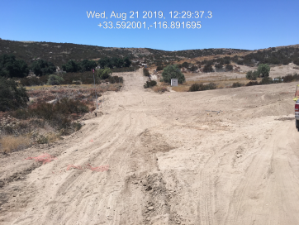
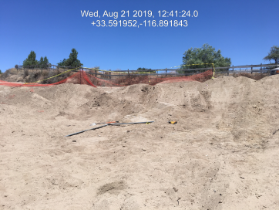
Case No: CV1903110
Situs Address: 44100 Ginger Circle, Hemet
APN: 571-040-002

Slide 2
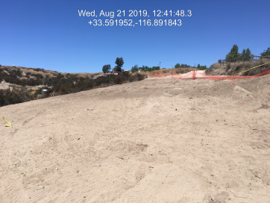
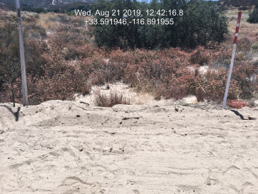
Case No: CV1903110
Situs Address: 44100 Ginger Circle, Hemet
APN: 571-040-002

Slide 3
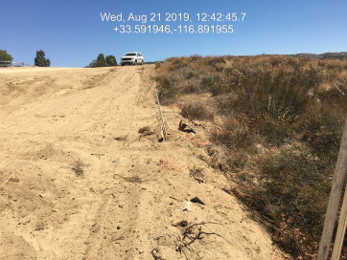
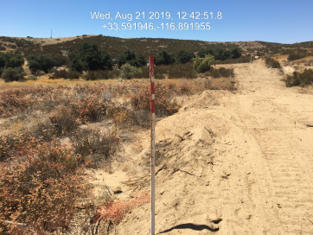
Case No: CV1903110
Situs Address: 44100 Ginger Circle, Hemet
APN: 571-040-002

Slide 4
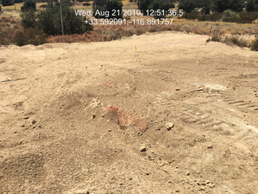
Case No: CV1903110
Situs Address: 44100 Ginger Circle, Hemet
APN: 571-040-002

Slide 5
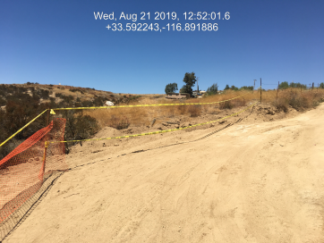
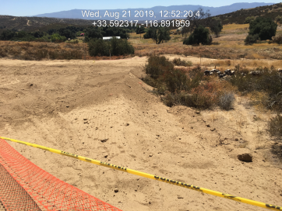
Case No: CV1903110
Situs Address: 44100 Ginger Circle, Hemet
APN: 571-040-002

Slide 6
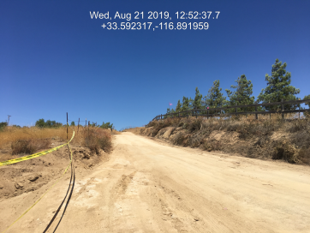
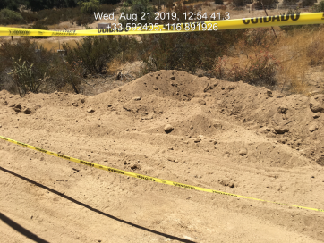
Case No: CV1903110
Situs Address: 44100 Ginger Circle, Hemet
APN: 571-040-002

Slide 7
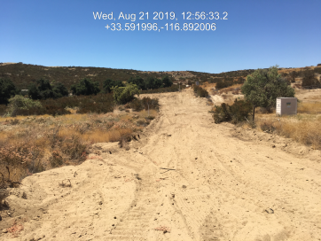
Case No: CV1903110
Situs Address: 44100 Ginger Circle, Hemet
APN: 571-040-002

Slide 8
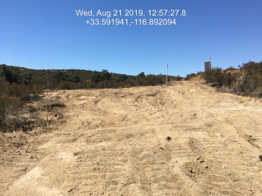
Case No: CV1903110
Situs Address: 44100 Ginger Circle, Hemet
APN: 571-040-002

Slide 9
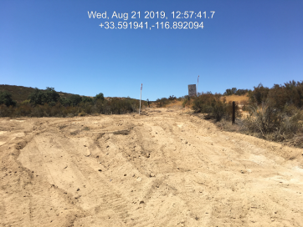
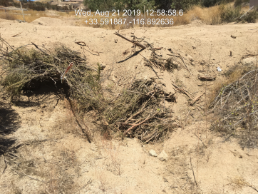
Case No: CV1903110
Situs Address: 44100 Ginger Circle, Hemet
APN: 571-040-002

